Slide 1
Lecture 2
Properties of Pure Substances

Slide 2
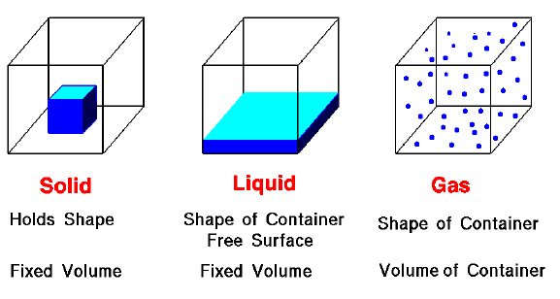
Lecture 2
Properties of Pure Substances
Phases of a Pure Substance:
Macroscopic Level:
3 States of Matter

Slide 3
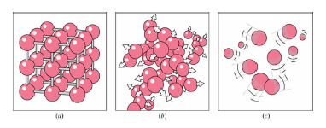
Lecture 2
Properties of Pure Substances
Macroscopic Level:
a) Solid: Intermolecular bonds are the strongest. The molecules are arranged in a 3- dimensional pattern (lattice), which is repeated throughout.
b) Liquid: Molecules are no longer at fixed positions and they can translate freely.
c) Gas: Intermolecular bonds are the weakest. There is no molecular order and molecules move about at random.

Slide 4
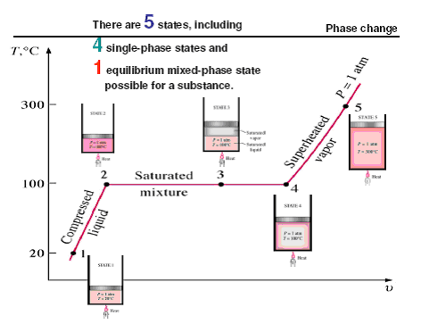
Lecture 2
Properties of Pure Substances
Phase Change:
1- Compressed or sub-­cooled liquid: The liquid is not about to vaporize.
2- Saturated liquid: The liquid is about to vaporize.
3- Saturated liquid and vapor: There is a mixture.
4- Saturated vapor: The vapor is about to condense
5- Superheated vapor: the vapor is not about to condense.

Slide 5
Lecture 2
Properties of Pure Substances
Saturation Temperature and Pressure:
Note:- The temperature at which a liquid starts boiling depends on the pressure and vice versa.
At a give pressure, the temperature at which a pure substance changes phase is called the saturation temperature.
At a given temperature, the pressure at which a pure substance changes phase is called the saturation pressure.
Latent heat:
The amount of energy absorbed or released during a phase-change process is called latent heat.
Latent heat of fusion is the amount of energy absorbed during melting.
Latent heat of vaporization is the amount of energy absorbed during vaporization.

Slide 6
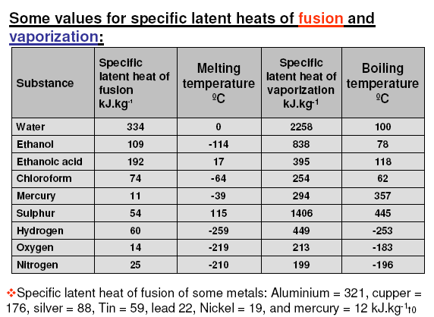
Lecture 2
Properties of Pure Substances

Slide 7
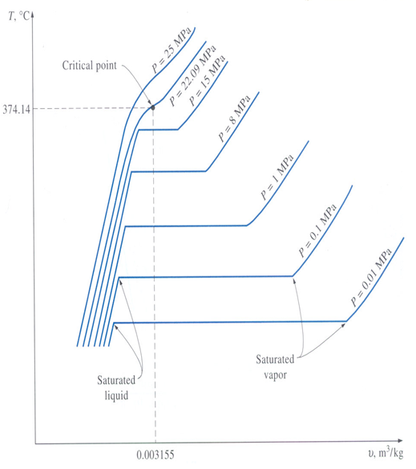
Lecture 2
Properties of Pure Substances
Property Diagrams for Phase-change Process
The T-V diagram
As pressure increases:
Water starts boiling at higher temperature
The specific volume of the saturated liquid becomes larger whereas the specific volume of the saturated vapor becomes smaller.

Slide 8
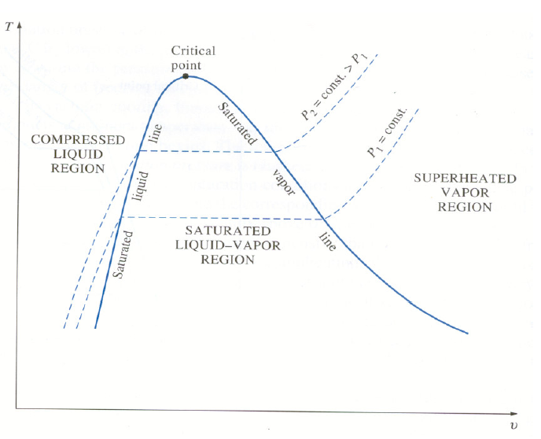
Lecture 2
The T-V diagram
Properties of Pure Substances

Slide 9
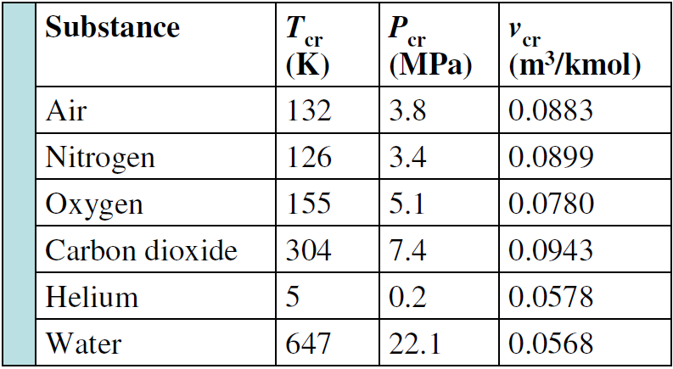
Lecture 2
Properties of Pure Substances
Critical point – the saturated liquid and saturated vapor states are identical.
At the critical point: T=T_{cr}, P=P_{cr}, and v=v_{cr}.
T_{cr} is the temperature above which a gas cannot be liquefied.
P_{cr} is the pressure that is needed to cause the gas to condense at T_{cr}.
At pressure above P_{cr},
there will be no distinct phase change process
Substances past the critical point are known as supercritical fluids.

Slide 10
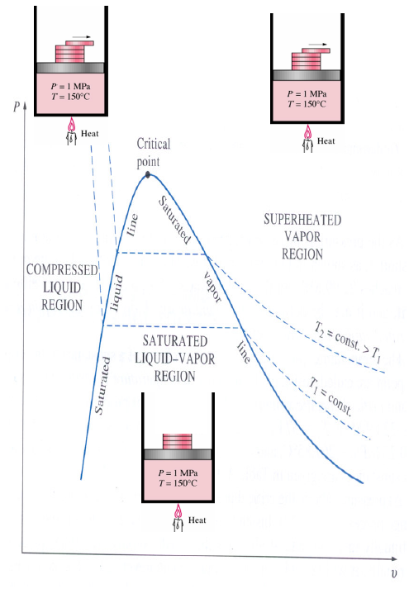
Lecture 2
Properties of Pure Substances
The P-v diagram
Consider compressed liquid water at 1 MPa and 150 °C.
When the pressure is reduced to P_{sat@150C} = 0.4758 MPa, the water will start to boil.
T and P remain constant during vaporization. Once the last drop is vaporized, P decreases whereas v increases.

Slide 11
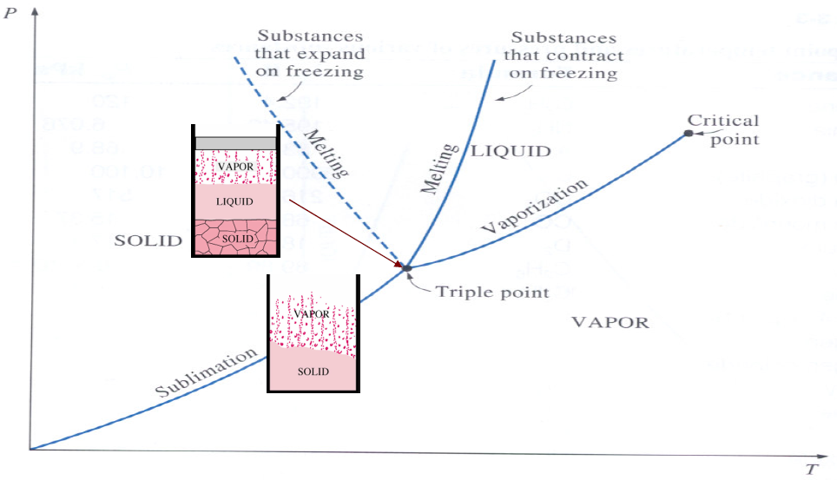
Lecture 2
Properties of Pure Substances
The P-T diagram (phase diagram)
The location at which the three phase change border lines meet is called the Triple Point.

Slide 12
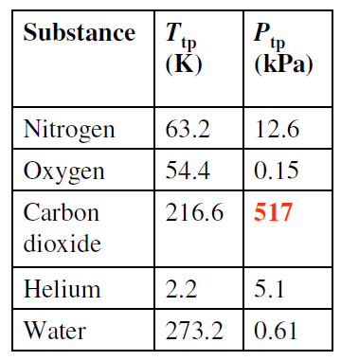
Lecture 2
Properties of Pure Substances
No substance can exist in the liquid phase at P < P_{tp}.
At P < P_{tp}, a substance can pass from the solid to vapor phase directly (sublimation) without passing through the liquid phase.
For carbon dioxide that has a large P_{tp} (>P_{atm}) sublimation is the only way to change from the solid to vapor phase at P_{atm}.

Slide 13
Lecture 2
Properties of Pure Substances
Thermodynamic Property Tables
Important thermodynamic properties are:
Temperature-T
Pressure-P
Volume-V (m³) and specific volume-v (m³/kg) = V/m
Internal energy-U,u (kJ, kJ/kg)
Enthalpy-H,h (kJ, kJ/kg):A combinational Property
H = U + PV or h = u + Pv (kJ)
Entropy-S,s (kJ/K, kJ/kg.K): A measure of system disorder

Slide 14
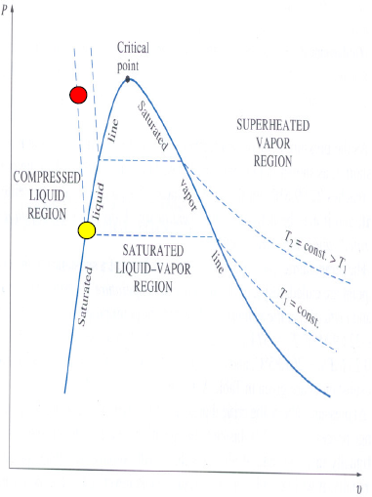
Lecture 2
Properties of Pure Substances
Compressed Liquid
Compressed liquid tables are not commonly available.
This is because of the relative independence of compressed liquid properties from pressure.
Increasing the pressure 100 times often causes properties to change less than 1 percent.
A general approximation is to treat compressed liquid as saturated liquid at the given temperature. i.e. v = vf @T, u = uf @T, h = hf @ T.
Characteristics of compressed liquid:
P>P_{sat} at a given T
T<T_{sat} at a given P
v<v_{f} ; u<u_{f} ;h<h_{f} at a given T or P

Slide 15
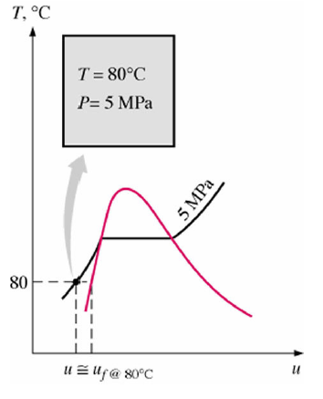
Lecture 2
Properties of Pure Substances
Example 2.1
Determine the internal energy of compressed liquid water at 80 °C and 5 MPa using
• (a) from the compressed liquid table?
• (b) saturated liquid data. What is the
error involved in the second case?
Solution:
• (a) From the compressed liquid table u = 333.73 kJ/kg
• (b) From the saturation table at 80 °C u = 334.86 kJ/kg
error = (334.86-333.72)/333.72 = 0.34 %

Slide 16
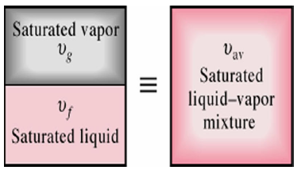
Lecture 2
Properties of Pure Substances
Saturated Liquid-Vapor Mixture
A saturated mixture can be treated as a combination of two subsystems:
Mass fraction of vapor or the quality:
x = 0 for purely saturated liquid
x = 1 for purely saturated vapor

Slide 17
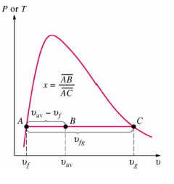
Lecture 2
Properties of Pure Substances
Average Values: The total volume is the sum of these two:
V = V_{f} + V_{g} ; m_{t} = m_{f} + m_{g}
m_{t} v_{av} = m_{f} v_{f} + m_{g} v_{g} = (m_{t} - m_{g})v_{f} + m_{g} v_{g}
Dividing by m_{t} yields:
v_{av} = (1 - x)v_{f} + x v_{g} = v_{f} + x v_{fg} m³/kg
Solving for the quality:
or v_{av} = v_{f} + x v_{fg} (m³/kg)
Similarly for internal energy and enthalpy:
u_{av} = u_{f} + x u_{fg} (kJ/kg)
h_{av} = h_{f} + x h_{fg} (kJ/kg)

Slide 18
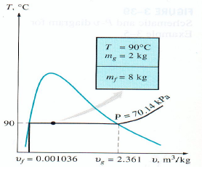
Lecture 2
Properties of Pure Substances
Example
A rigid tank contains 10 kg of water at 90 °C. If 8 kg of the water is in the liquid form and the rest is in the vapor form,
determine
(a) the pressure in the tank and
(b) the volume of the tank.
Solution:
(a) since the two phases coexist in equilibrium:
P = P_{sat} _{at 90°C} = 70.14 kPa (Table 2.4)
(b) v_{f} = 0.001036 m³/kg; v_{g} = 2.361 m³/kg (Table 2.4)
V = V_{f} + V_{g}
V = m_{f} v_{f} + m_{g}v_{g}
= (8 kg)(0.0011036 m³/kg) + (2 kg)(2.361 m³/kg)
= 4.73 m³

Slide 19
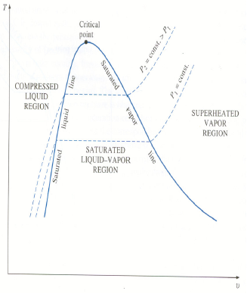
Lecture 2
Properties of Pure Substances
Superheated Vapor
Since the superheated region is a single-phase region, temperature and pressure are no longer dependent properties.
Characteristics of superheated vapor:
P<P_{sat} at a given T
T>T_{sat} at a given P
v>v_{g} ; u>u_{g} ; h>h_{g} at a given T or P.

Slide 20
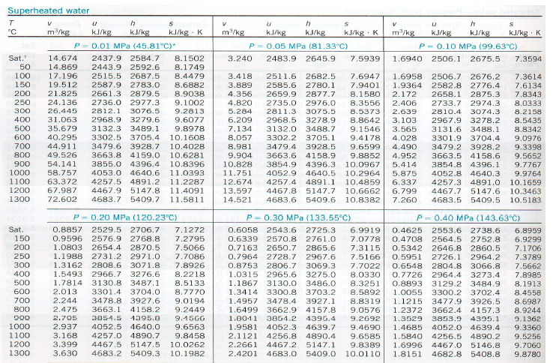
Lecture 2
Properties of Pure Substances

Slide 21
Lecture 2
Properties of Pure Substances
Example
Determine the temperature of water at a state of P = 0.5 MPa and h= 2890 kJ/kg.
Solution:
At 0.5 MPa, the enthalpy of the saturated vapor is h_{g}=2748.7 kJ/kg.
Since h > h_{g} =>, it is a superheated vapor.
Under 0.50 MPa in the following table we read that:
At T = 200ºC, h = 2855.4 kJ/kg,
and at T = 250ºC, h = 2960.7 kJ/kg.
Thus T is between 200ºC and 250ºC. By linear interpolation,
T = 216.4ºC

Slide 22
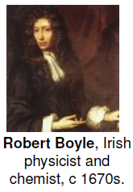
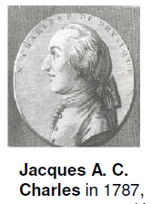
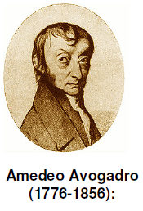
Lecture 2
Properties of Pure Substances
The Ideal-Gas Equation of State - history
The pressure of gases is inversely proportional to their volume (for a fixed mass of gas at a constant temperature T).
At a constant (but low) pressure the volume of a gas is proportional to its temperature.
under conditions of the same temperature and pressure, equal
volumes of all gases contained equal number of molecules.

Slide 23
Lecture 2
Properties of Pure Substances
The Ideal-Gas Equation of State
Any equation that relates the pressure, temperature, and specific volume of a substance (or whatever else) is an equation of state.
Ideal-gas equation of state:
R = gas constant which is different for each gas (in kJ/kg.K or kPa.m³/kg.K)
P = absolute pressure (in kPa)
T = absolute temperature (in K)
m = mass (in kg)
v = specific volume (v = V/m) in kg/m3
r = density ( = 1/ v) in m3/kg

Slide 24
Lecture 2
Properties of Pure Substances
In terms of mass:
PV = mRT
In terms of mole:
PV = nRuT
so:
nRu = mR Ru = R(m/n)=RM
n = number of moles
M = the molar mass (mass of one mole) or molecular weight (m = nM)
Ru = universal gas constant = 8.314 kJ/kmol.K = 8.314 kPa m^{3/}kmol.K
Note:-
Many familiar gases such as air, nitrogen, oxygen, hydrogen, helium, argon, and carbon dioxide follow the ideal gas relation with negligible error (less than 1 percent).
Dense gases such as water vapor should not be treated as ideal gases.

Slide 25
Lecture 2
Properties of Pure Substances
Is water vapor an ideal gas?
At pressure below 10 kPa, water vapor can be treated as an ideal gas, regardless of
Temperature
No – high pressure steam in power plant applications
Yes – air conditioning applications

Slide 26
Lecture 2
Properties of Pure Substances
Compressibility Factor (Z)
Z is a measure of deviation from Ideal-gas behavior.
Z = 1, ideal gas
Z <> 1, non-ideal or real gas
Experimental finding: Gases behave differently at a given temperature and pressure, but they behave very much the same at temperatures and pressures normalized with respect to their critical temperatures and pressures.

Slide 27
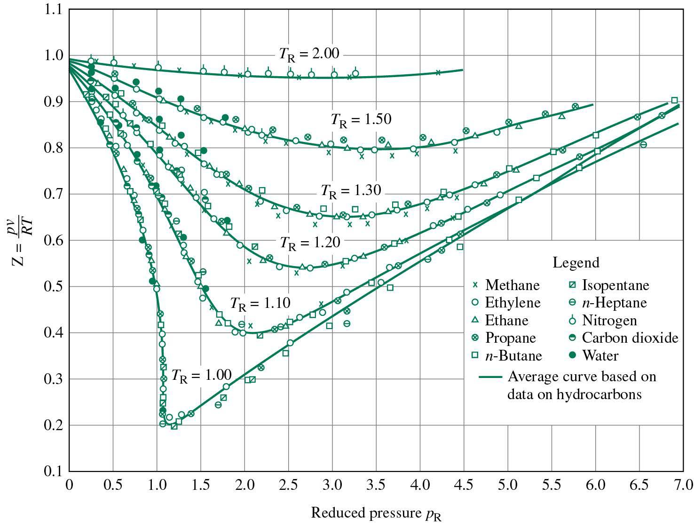
Lecture 2
The generalized compressibility chart
Properties of Pure Substances
PR = reduced pressure
TR = reduced temperature
v_{R} = pseudo-reduced specific volume

Slide 28
Lecture 2
Properties of Pure Substances
Example
Determine the pressure of water vapor at 300 °C and 0.08114 m3/kg using
a) steam table,
b) the ideal gas equation (R=0.4615 kJ/kg.K)
c) the generalized compressibility chart.
Solution:
a) From the table, P = 3.0 MPa. This is the experimentally determined value.

Slide 29
Lecture 2
Properties of Pure Substances
b) Ideal gas
P = RT/v = (0.4615 kJ/kg.K) ×(573.15 K)/(0.08114 m3/kg)
P =3,260 kPa = 3.26 MPa
c) Real gas
For water: Tcr = 647.3 K; Pcr = 22.09 MPa
TR = T / Tcr = 573/647.3 = 0.89
From the chart PR = 0.135
P= PR × Pcr = 0.135 × 22.09 = 2.98 MPa

Slide 30
Lecture 2
Properties of Pure Substances
Some other properties of pure substances
Density - mass per unit volume (mL-3)
ρ= m/V (kg/m3)
For liquids the effect on the density by variations in pressure and temperature is generally small.
Specific weight - weight per unit volume (FL-3)
Specific Gravity - the ratio of the density of a substance to the density of some standard substance at a specified temperature, usually water at 4 °C.
Specific Heat- The specific heat is the amount of energy per unit mass required to raise the temperature by one degree Celsius.
The value of C depends on the nature of the process undergone during the energy transfer.
Cv: at a constant volume
Cp: at a constant pressure

Slide 31
Lecture 2
Properties of Pure Substances
For liquids and solids Cv = Cp = C.
For gases Cp > Cv.
Definitions of Cv and Cp for real gas:

Slide 32
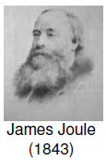
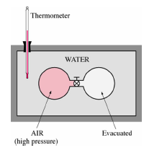
Lecture 2
Properties of Pure Substances
Specific Heat Relations of Ideal Gases:
Joule’s experiment:
Initially one phase contained air at a high pressure and the other phase was evacuated.
When the valve was opened and the thermal equilibrium was reached, no change in temperature was observed.
u = u (T)
For ideal gas, u is a function of T only.
similarly:
h = h (T) (because h = u + Pv, Pv = RT h = u + RT)
Because h = h(T) and u=u(T), so:

Slide 33
Lecture 2
Properties of Pure Substances
Relation between Cp and Cv:
dh = du +RdT
CpdT= CvdT+RdT
Cp= Cv+R
or Cp- Cv= R
Specific heat of gases
Specific heats of air (nitrogen and oxygen) and water change with temperature.
Specific heat of various common gases at constant pressure are usually available in terms of kJ/kmol.K as a function of temperature.

